Slide 1
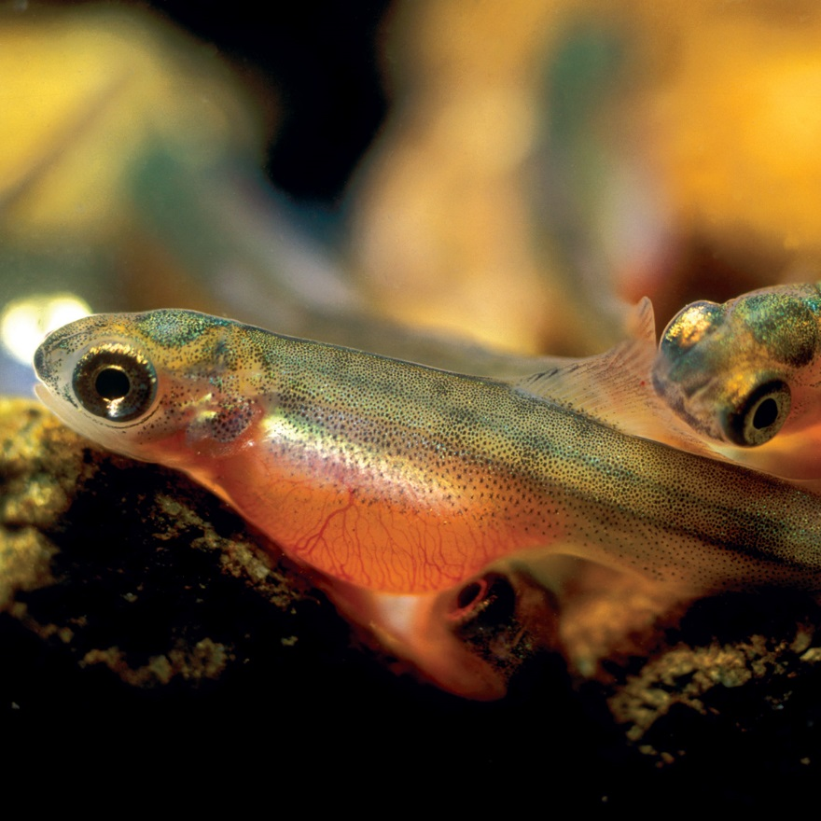
Total Dissolved Gas and Dam Operations
North Santiam River
Total Dissolved Gas Task Group (W-FPOM)
13 September 2017
Photo: CRITFC website, Jeffrey Rich

Slide 2
Issue
Total Dissolved Gas (TDG) caused by spill has negative impacts to salmonids below Big Cliff Dam in the North Santiam River (other rivers as well).

Slide 3
Purpose
Discuss How to Reduce Total Dissolved Gas / Impacts
Spill Configuration
Turbine maintenance periods
Willamette Fish Operations Plan
Notes:
Fish impacts, incorporate changes into WFOP

Slide 4
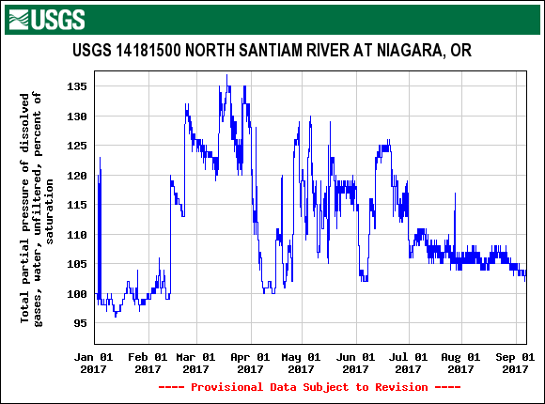
TDG Levels (2017)
Notes:
2017 abundant water year

Slide 5
Big Cliff Discharge (Annual)
Internal:
http://nwp-wmlocal2.nwp.usace.army.mil/nwdp/nwp_teacup/www/willamette/bcl.pdf
External:
http://www.nwd-wc.usace.army.mil/nwp/teacup/willamette/bcl.pdf

Slide 6
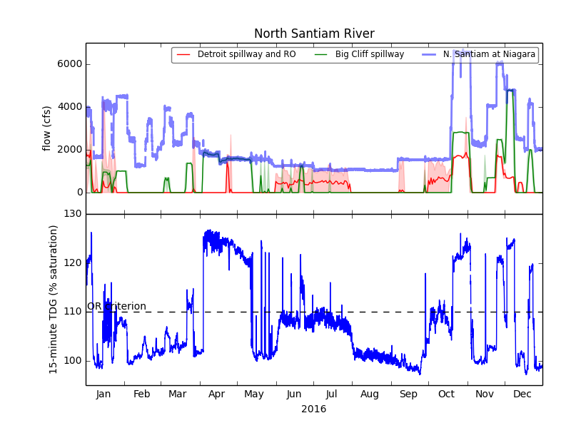
TDG AND discharge (2016)
Notes:
Causes: spill (flood operations, turbine maintenance)

Slide 7
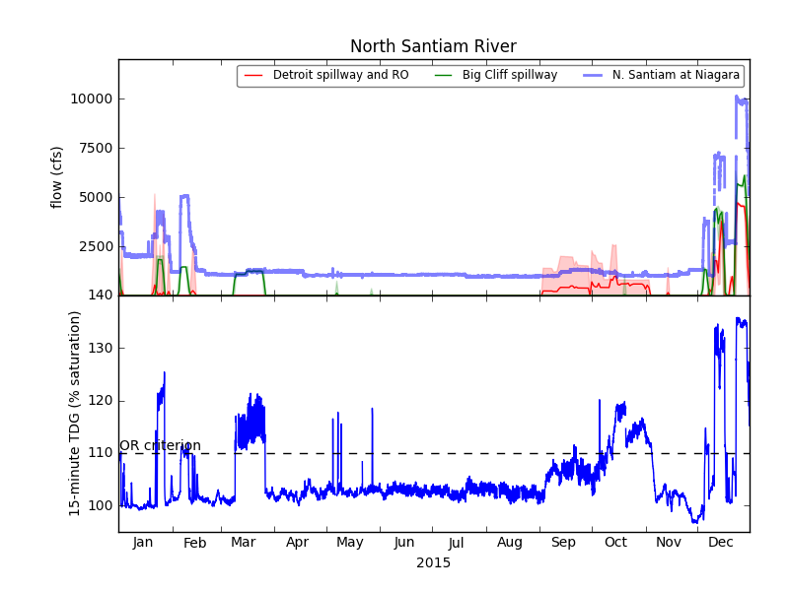
TDG AND discharge (2015)

Slide 8
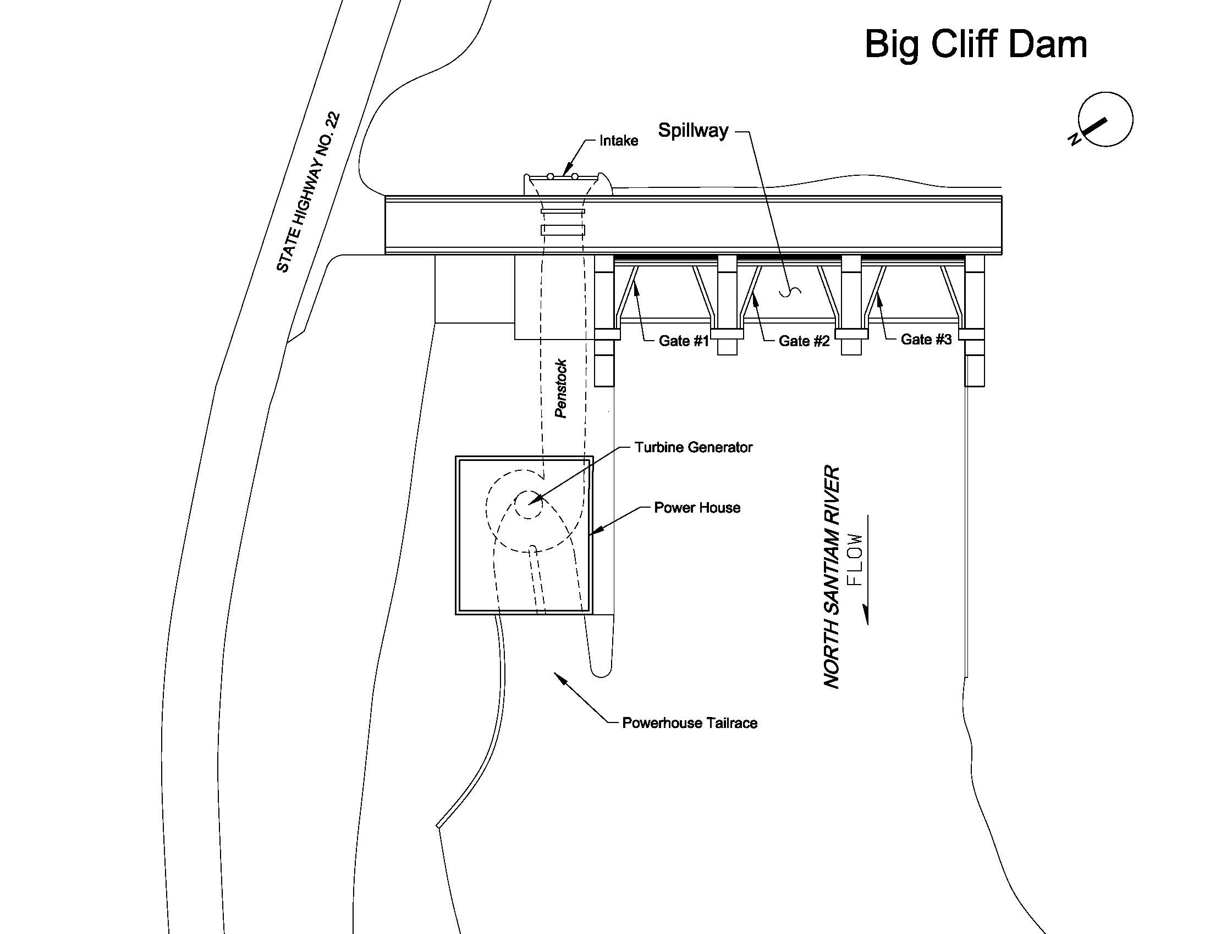
Big Cliff Dam
1 2 3

Slide 9
Gate Rating Table – Big Cliff Dam
Examples over power pool elevation range:
Forebay Elevation 1,185 ft => 1,370 cfs ----- (TDG~120%)
Forebay Elevation 1,190 ft => 1,810 cfs
Forebay Elevation 1,195 ft => 2,280 cfs
Forebay Elevation 1,200 ft => 2,800 cfs
Forebay Elevation 1,205 ft => 3,340 cfs ----- (TDG~130%)

Slide 10
ACTions
Change Spill Configuration
“When operating the spillway (SW), the initial gate opening (GO) will be to the minimum set by the SW rating table (RT) for the current lake elevation.
As the lake elevation or desired outflow changes, continue with the single gate opening until a second gate can be opened. Set that second SW GO to the minimum set by the SW RT for the current lake elevation.
With increasing desired outflow continue to spread flow across the available SW gates, setting each gate to at least the minimum SW GO.
If a higher level of spill is desired and all gates are set to the minimum SW GO, increase the GO of the middle gate until the desired outflow is achieved. With increasing SW flow, increase the gate openings so that the middle gate has the largest opening and the gates on the left and right sides have the smaller gate opening. This will channel the flow down the center of the raceway and will reduce bank erosion.
This operation will ensure that the SW gates are operated in the range that causes less vibration on each gate, will potentially reduce total dissolved gas production, and will allow for larger gate openings for safer downstream fish passage.”

Slide 11
Actions (cont)
Change/Adjust Turbine Maintenance Periods
Current Maintenance Periods:
Mar 1-Jun 30: Primary target period.
Jul 1-Aug 31: Limited outage scheduling due to power valuation considerations.
Sep 1-Oct 31: Secondary target period.
Nov 1-Feb 28: Restricted from outage scheduling.
Notes:
Sep 1-Oct 31: The secondary outage period is not preferred but outages are allowed.
Nov 1-Mar 31: Minimize generation outages in order to maintain TDG below limit due to impacts on sac fry.
Proposed Change/Adjustment: ???

Slide 12
DISCUSSION / Options / Recommendations / Next Steps
???
Incorporate into Willamette Fish Operations Plan (WFOP)
Notes:
These are things we can do - DiscussionWhat is habitat like in the reach from Big Cliff to Minto

Slide 13
Willamette Teacup
Internal:
http://nwp-wmlocal2.nwp.usace.army.mil/nwdp/nwp_teacup/www/willamette/
External:
http://www.nwd-wc.usace.army.mil/nwp/teacup/willamette/

Slide 14
TDG Longitudinal profile, Big Cliff => Minto (2017)
Big Cliff

Slide 15
Notes
Web/WFOP outage period link
time turbine outages when flow and TDG is going to be high already, another period suggested in the past was August, lay out fish life history timing, ChS and StS
Call GT
Slide, fish outplanting,

Slide 16
Outline (adjust according to pres)
Issue
Purpose
TDG
Actions
Notes:
Maybe add no TDG periods so we can incorporate other actions that cause spill (surveys)

